Slide 1
4Sight
Overview and Demonstration

Slide 2

Agenda
  4Sight Value
  4Sight Facts
  Capability Walk Through
  Modules Overview
  Next Steps
  Questions and Answers

Slide 3
How Can 4Sight Support a GDIT Program?
Excel spreadsheets
Access database
Homegrown solution
Lack of backup
On customer network
ACCESSIBLE
TRACKING
Intuitive web based application available from anywhere
Better accountability for tracking assets, travel, positions, training
Transition From
Mission focused
Purpose built
Workflow engine
Customizable to business processes
Modular costing
THE
VALUE OF MANAGED SERVICES
Highly Tailorable
The Value of 4Sight
External to GDIT
Can support subcontractors
Can support customer
Azure GovCloud
FedRAMP High
Accessible & Secure
FLEXIBILITY
COMPLIANCE
Custom development available to meet any program specific requirements
Contract deliverables tracking & scheduling to ensure program compliance

Slide 4









4Sight Facts
Web Hosted
  Microsoft’s Azure Government Community Cloud High (GGCH)
US Federal Risk and Authorization Management Program (FedRAMP)
Accessibility
  508 Compliant
  High Accreditation
Quality Assurance
  Dev
  QA
  Prod
  SDLC
Availability
Tech Stack
99.9%
Local Redundant
Geo-Redundant
ASP.Net
ASP.Net Core
C#
HTML
JavaScript
Azure Environment
Security
Modular
Azure Load Balancer
Storage Services
Azure SQL Server
Virtual Network
Azure Recovery for DR
Application health checks
Firewalls rules for ingress traffic
RBAC
Purpose built
Cost savings

Slide 5
Mission and Capabilities of 4Sight
Mission is to deliver management products to help Program Managers visualize, monitor, and measure program financial health and progress. To provide optimization and methodology to help programs run efficiently
4Sight Program Management Services
Performance Reporting & Analytics
Purchase Requests
Asset Management
Training Services
ROM Development
Risk Management
Travel Planning
Notes:
The capabilities of 4sight.
It’s a suite or collection of products that are interconnected, they’re scalable, and they’re secure and they provide oversight and solutions for program management.
It provides these managers with modules and applications to gather and store asset information as well as team information.
It also provides analysis tooling and reporting for risks, QA, and data trends analysis.

Slide 6
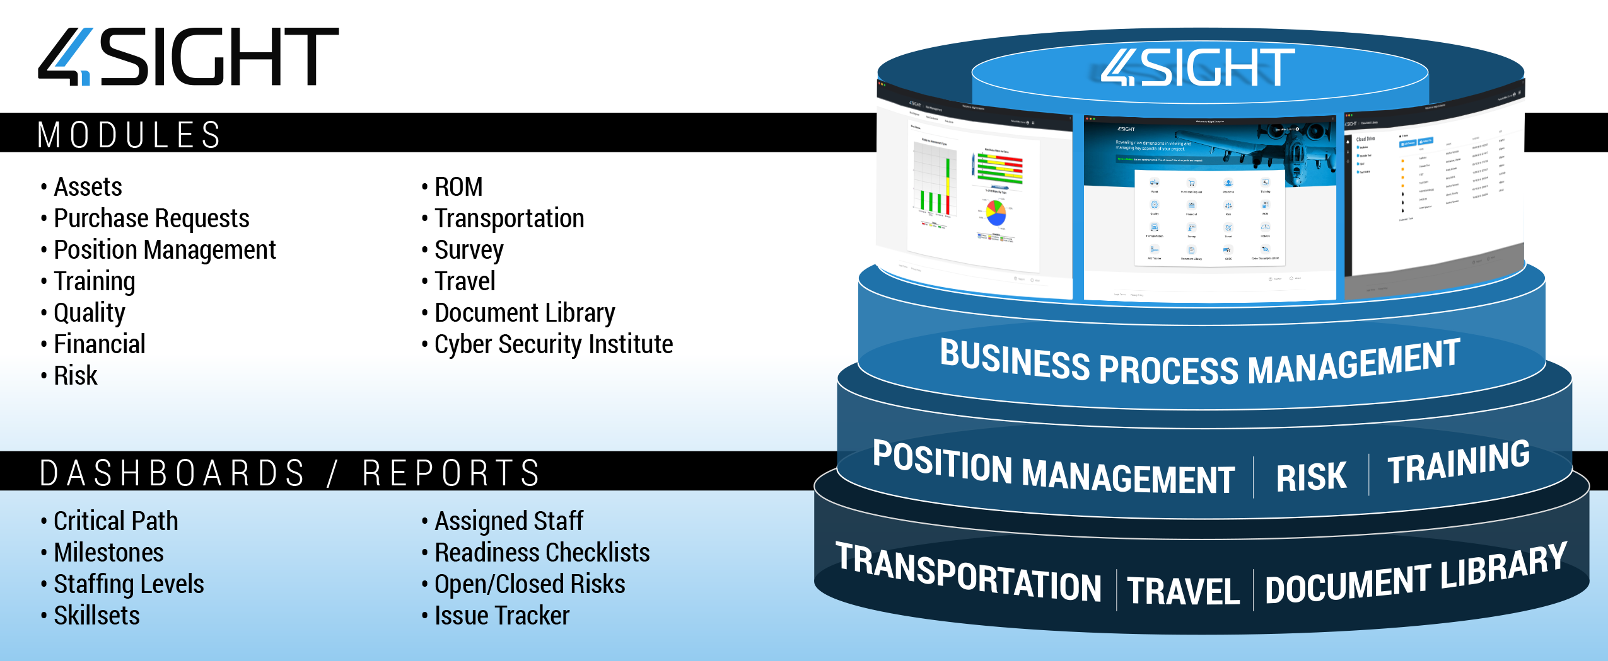
Mission and Capabilities of 4Sight
4Sight is a GDIT developed and owned portfolio of products with interconnected scalable and secure program solutions to meet the needs of program management, program measurement, and knowledge management. 4Sight provides project and program managers with modules and applications to gather and store team and asset information, as well as superior analysis tools and reporting structures for action decisions, quality assurance compliance, and trend analysis.
Notes:
The capabilities of 4sight.
It’s a suite or collection of products that are interconnected, they’re scalable, and they’re secure and they provide oversight and solutions for program management.
It provides these managers with modules and applications to gather and store asset information as well as team information.
It also provides analysis tooling and reporting for risks, QA, and data trends analysis.

Slide 7











Capabilities of GDIT 4Sight
A project can elect to use any or all the modules 4Sight modules. Creation of custom modules could be built as well.
Asset Management
Position Tracking
Travel Planning & Processing
Listing and auditable tracking of inventory and equipment
Electronic hand receipts
Workflow with electronic signatures
Associate document attachments
Manage job groups and positions
View employee /position and history data
View primary and subcontractor data
Personnel Status (PERSTAT) reporting
Create travel requests and detailed itineraries
Charge travel to proper funding lines and ensure funding is available with "checkbook" function
Compliance with FEDSIM requirements
Customer approval workflow
Purchase Requests
Survey
Create purchase requests
Create contract required property requests
Workflow to request material and gain approval
Collect customer or end user feedback
Easy access worldwide to submit feedback.
Provides Task Order staff with survey responses in electronic format for data collection and analysis.
Gives the customer the option to complete in private and email form to QAM and/or the email addresses provided by contractor.
Sends an email alert to the QAM when there is a survey completed with low ratings.
Transportation
Automated real-time transportation reports viewable by GDIT and customer
Email alerts (that include DD1149 form attachments) to notify POC of incoming shipment
Automated DD1149 forms generated through and stored in the system
Transparency; users can check on the status of shipments at any time worldwide create receipt function; receipt views for opened and closed receipts
Ability for tracking of all shipments
Advanced search function
ROM Estimates & Approval Records
Customer ability to submit ROM requests, track, monitor and approve
Excel templates to create ROMs
Comment tools to track discussion with customer
Easy access worldwide to retrieve ROMs
All calculations automated by location/site
Area for comment threads between users, government customers, and CSC for transparent communications
Email alerts
Opened and Closed views, report generation, export to Excel and Print functions
Advanced search function
Document Library
Public/private folder structure
Store contract deliverables
Subscribe to updates
Team access for All CDRLs (Contract Deliverables) and other ad hoc reports are resident in the Document Library.
Public and private libraries - Flexible configuration allows Libraries to be set so only users provided access can view and download documents.
Users may choose to subscribe to libraries or folders within a library and will receive email alerts when a new document is uploaded.
Users worldwide can access the libraries 7 days a week, 24 hours a day.
Training
Track training requirements and adherence by job category
Manage training assignment and reports for all personnel, including subcontractors
Deliver training to personnel and organize classes
Quality/Safety Plans & Records
Manage inspections and audits
View list of all active findings
Manage preventative and corrective actions
Track root cause analysis
Perform quality analysis
Risk Management
Risk identification, response and control
Probability and impact modeling supporting contingency budgeting
Notes:
Asset Management: Provides…
Oversight and control through workflows and lifecycles that each asset must follow. And allows for auditing and tracking as well as electronic receipts and signatures as it moves through that lifecycle. Notifications can also be sent out as it moves through the lifecycle.
Offers the ability for historical records of assets to be maintained and accessed.
Can link and store documents that are pertaining to specific assets. For example: warranty information, user guides, maintenance information, purchase orders, etc.
All the data is stored in one central location that’s safe and secure. It can be controlled through role based access from anywhere; eliminating the need to pass around Excel spreadsheets, Access databases, or other cumbersome solutions.
Purchase Requests: A tailored workflow that enables users to request material and gain approval for purchase from authorized personnel, then generate a requisition and make available to the buyer for fulfillment.
ROM Estimates & Approval Requests: Another workflow enabling users to submit requests for ROMs, for those ROMs to be worked and submitted, as well as an approval process for the ROM.
Quality / Safety Plans & Records: A convenient pipeline dashboard providing inspection planning tools and complete visibility of all active findings with the ability to drill down into the details of those findings. Workflow documentation, corrective actions, preventive actions, root cause analysis, verification of effectiveness are all provided in this module.
Position Tracking: People and Position data to view staff status for both primary and subcontract employees and support updates for the Training Module that is interconnected. This allows a project to ensure that the staff attains and maintains the correct levels of training and certifications per their customer requirements.
Survey: Collect feedback to verify best practices and identify needed areas improvements so that there can be continuous product improvement.
Document Library: Role based document archive that allows for both working drafts and delivered documentation.
Travel Planning & Processing: Tracks travel requests and itineraries with builtin customer approval mechanisms. Allows for attachments; tailored workflows and approval processes.
Transportation: A solution for automating shipment reports between location sites. Provides automated transportation reports, updated in real time.
Training: Track current certification and training history. Assign training requirements based on job types and location. Mnage certifications, licenses, classroom training, external training, computer based training and job task training.
Risk Management: Module to track risks at the program level. It guides you through the entire risk management process from identification, response, and control.

Slide 8

Position Tracking
A module that provides HR and Program Management access to view employee/position and history data, including current position held. This level of employee/position tracking allows a project to ensure staff attains and maintains the correct levels of training and certification to meet customer requirements.
People and Position data to view staff status for both primary and subcontract employees and support updates for the Training Module
Manage job groups and positions
View employee /position and history data
View primary and subcontractor data
Personnel Status (PERSTAT) reporting

Slide 9

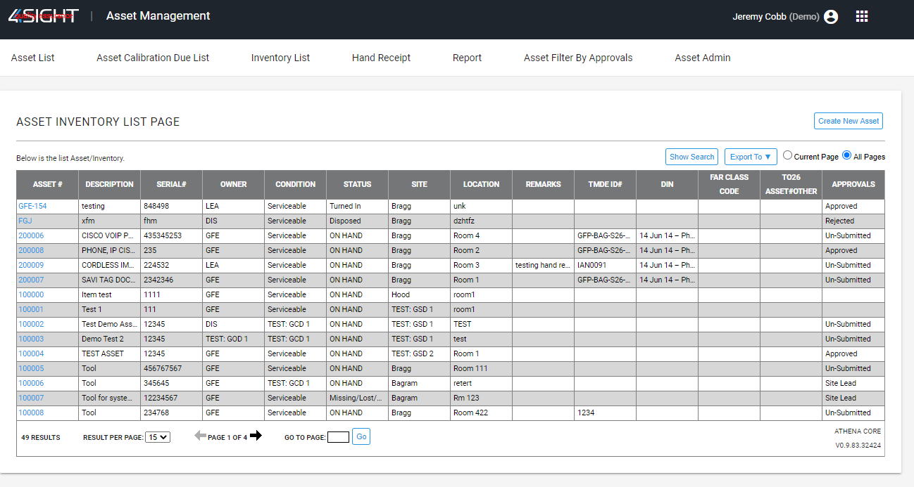
Asset Management
Oversight and control through defined workflows and lifecycles.
Auditing and tracking as well as electronic receipts and signatures
Listing and tracking of inventory and equipment.
Linking and store documents to specific assets to help track warranty information, user guides, maintenance information, purchase orders, etc.
Role based access to data from anywhere.
Customizations that allow for import and export of asset data per clients specific

Slide 10

Document Library
A role based module to serve as a library or repository of documentation.
Upload/Download working drafts or delivered documents.
Access is both role based and staff position based.
Store contract deliverables
Subscribe to updates
Team access for all contract deliverables and other ad hoc reports
Public and private folder structures and libraries
Folder and Library subscriptions enabling the ability for users to receive email alerts on document uploads and changes.

Slide 11

Purchase Requests
A tailored workflow that enables users to request material and gain approval for purchase from authorized personnel, then generate a requisition and make available to the buyer for fulfillment.
Mechanism for creating purchase requests
Creating contract required property requests
Workflow to request material and gain approvals

Slide 12

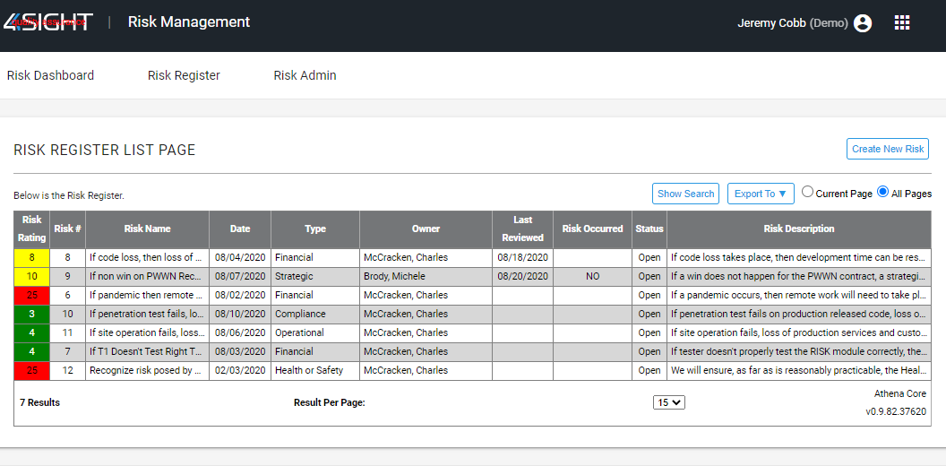
Risk Management
A module to easily manage program risks in alignment with company best practices.
Risk identification, response and control
Probability and impact modeling supporting contingency budgeting
The Risk module guides end users through the risk management process from identification, risk response, and risk control. Probability and impact inputs are used for determining a contingency reserve budget for the risk.

Slide 13

Training
Track certification standing and training history and deliver project training
Define and track training requirements and adherence by job category
Manage training assignment and reports for all personnel, including subcontractors
Deliver training to personnel and organize classes
Manage certifications, licenses, classroom training, external training, computer based training and job task training.

Slide 14

Quality / Safety Plans & Records
A convenient pipeline dashboard that enables management of inspections and audits, and to implement change. This module provides inspection planning tools and complete visibility of all active findings with the ability to drill down into the details of those findings. Workflow documentation, corrective actions, preventive actions, root cause analysis, verification of effectiveness are all provided in this module.
Manage inspections and audits
View list of all active findings
Manage preventative and corrective actions
Track root cause analysis
Perform quality analysis
Summary list of items requiring user’s action.
Quality Managers determine the level of workflow they desire for any given finding. Charts and reports assist with analysis and trending.
The Contract Finding Pipeline enables viewing, tracking and measuring results associated with all audit and inspection programs.

Slide 15

ROM Estimates & Approval Records
A tailored workflow enables users to complete cost estimates for customers quickly and easily.
Customer ability to submit ROM requests, track, monitor and approve
Excel templates to create ROMs
Comment tools to track discussion with customer
Easy access worldwide to retrieve ROMs
All calculations automated by location/site
Area for comment threads between users, government customers, and CSC for transparent communications
Email alerts
Opened and Closed views, report generation, export to Excel and Print functions
Advanced search function

Slide 16

Transportation
A program solution that was developed for automating our shipment report between the RSCs and other contract location sites.
Automated real-time transportation reports viewable by GDIT and customer
Email alerts (that include DD1149 form attachments) to notify POC of incoming shipment
Automated DD1149 forms generated through and stored in the system
Transparency; users can check on the status of shipments at any time worldwide create receipt function; receipt views for opened and closed receipts
Ability for tracking of all shipments
Advanced search function

Slide 17

Travel Planning & Processing
A module to help track travel requests and itineraries through tailored workflows
Create travel requests and detailed itineraries
Charge travel to proper funding lines and ensure funding is available with "checkbook" function
Compliance with FEDSIM requirements
Customer approval workflow
Travel documentation and attachments
Tailored approval workflow by site/location allowing for both contractor and customer participation.
Generated FEDSIM approved TAR (Travel Authorization Request) form that can be exported

Slide 18

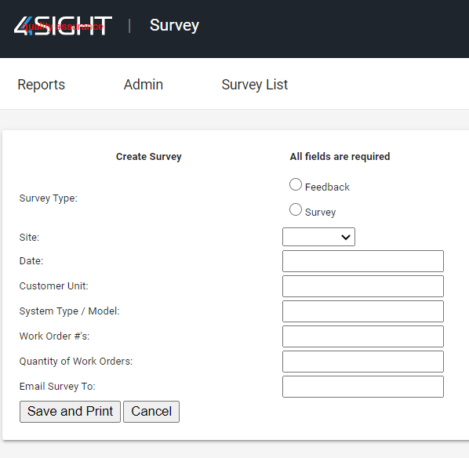
Surveys
A module that collects feedback to verify best practices and identify needed improvements for continuous product improvement.
Collect customer or end user feedback
Easy access worldwide to submit feedback.
Provides Task Order staff with survey responses in electronic format for data collection and analysis.
Gives the customer the option to complete in private and email form to QAM and/or the email addresses provided by contractor.
Sends an email alert to the QAM when there is a survey completed with low ratings.

Slide 19
Performance Dashboards
Performance Dashboards provides quick access to important program information at a glance.
  Currently five modules are displayed in the Dashboard:
  PR/CAPR – provides a snapshot of PR status to ensure metrics are being met with green, amber, and red symbols to easily identify PRs that require immediate attention.
  PERSONNEL – shows the number of personnel and the number of vacancies at each location. The user can click on the graph to download the latest personnel report.
  MMS – provides the number of closed and open works orders at each location. A second chart breaks out the age of work orders by location.
  ROM – provides a chart of the number of open ROM requests and their current status. The user can click on a status and be directed to the ROM Module to view ROM requests in further detail.
  CDRLs – a listing of the latest CDRLs uploaded into the CDRL Library. The user can click on the desired CDRL to download the report rather than navigating to the CDRL Library.

Slide 20


Custom Development
Out of the box, 4Sight can solve most, if not all, of your program’s needs. In some case, customization is needed to track and display specific program data either from an internal form within 4Sight or consumption of data from an external data source.
Additionally, an entirely customized module can be developed for the program’s needs and made available exclusively to your program. Because we own the code, 4Sight is extremely flexible allowing us to adjust processes and workflows as needed.
For Example: Global Combat Support System-Army (GCSS)
A custom companion module that provided:
Procure, stock/store, manage, and consume Class II non-expendable material, and Class VII Equipment
Reports include Demand Analysis, Issued Material, and Transportation
When an item is purchased via the PR Module and marked as a GCSS item, the PR Module automatically generates those items in the Unmanaged Materials section of the GCSS Module
When materials are assigned a work order number and issued, they can be imported in the Transportation Module when creating shipments
Notes:
Out of the box 4sight can provide most if not all a programs needs.
However in some cases customizations maybe needed to track and display specific program data.
Customized modules can be developed for that programs needs and made exclusive.

